Slide 1


International Conference on Emerging Trends in Computers and Communications (ICETCC )
AI-Powered Predictive and Reinforcement Learning System for Energy Optimization in Industrial and Commercial Buildings
Paper ID: 632
Atharva Khairnar
Vishwakarma Institute Of Technology ,Pune

Slide 2
Introduction
Problem Statement - Buildings use more energy than needed because current systems can’t adjust well to changes in people, weather, and usage. This causes higher bills and more pollution. Thus, this project uses AI to predict and manage electricity use in big buildings (like offices or factories) to save energy and reduce costs, while keeping people comfortable.
Rising industrial and commercial energy demand is causing higher costs, grid load, and environmental impact.
Proposed solution:
An AI framework combining time-series forecasting and reinforcement learning.
Forecasting predicts next-day energy demand using historical usage patterns.
RL(reinforcement learning) optimizes scheduling of high-load devices to reduce wastage and peak demand charges.
Built fully from scratch with core algorithms, unlike existing subsystem-specific solutions.
Scalable for offices, IT parks, factories, hotels, and future smart-city applications.

Slide 3
Purpose
Rising energy costs and climate change concerns demand smarter energy management solutions.
In commercial and industrial buildings, HVAC(Heating, Ventilation, and Air Conditioning) and lighting account for 50–70% of total energy use, yet are often operated inefficiently.
Traditional rule-based control systems cannot adapt to dynamic factors like occupancy, weather, or real-time demand.
AI-driven forecasting and optimization (using PPO + LSTM) offers the opportunity to achieve significant energy savings while ensuring occupant comfort.
This project aims to contribute towards sustainable development goals (SDGs) by reducing energy waste, lowering emissions, and enabling smarter infrastructure.

Slide 4
Objectives
Objective - Design an intelligent energy management system that predicts energy demand patterns and applies reinforcement learning to optimize energy consumption in real time. By combining accurate forecasting with adaptive control, the system aims to minimize costs, improve efficiency, and support sustainability goals in industrial and commercial buildings, while providing actionable insights through an interactive application.
1.To forecast building energy consumption using predictive models (LSTM).
2.To optimize energy usage dynamically with reinforcement learning (PPO).
3.To reduce overall energy costs while maintaining operational efficiency.
4.To improve sustainability by lowering carbon footprint in industrial/commercial buildings.
5.To create a user-friendly web/app interface for real-time insights and recommendations.
6.To evaluate performance using real or simulated building datasets

Slide 5
Literature Review
Sr. No. | Title of Research Paper | Authors | Name of Journal/Conference | Date of Publication (Month and Year) | Methodology | Performance Measure or Results
1 | Machine Learning Models for Energy Efficiency in Industrial Equipment |  |  | 2024 | Random Forest SVM (Support Vector Machine) Gradient Boosting | Random Forest achieved around 92% accuracy in predicting how efficiently a machine is operating—better than SVM or Gradient Boosting.
2 | Potential of artificial intelligence in reducing energy and carbon emissions of commercial buildings at scale | Chao Ding, Jing Ke & Nan Zhou (affiliated with Lawrence Berkeley National Laboratory and others) | Nature Communications | 2024 | Scenario-based modeling—six scenarios across climate zones and building types, combining AI-driven improvements in equipment, occupancy modeling, operational control, and building design; simulation using EnergyPlus baseline models | AI alone could reduce energy consumption and carbon emissions by approximately 8%–19% by 2050. When combined with aggressive energy policy and low‑carbon power, reductions become ~40% energy and ~90% emissions vs business‑as‑usual by 2050
3 | An Experimental Evaluation of DRL Algorithms for HVAC Control | . |  | 2024 | Deep Reinforcement Learning (DRL) PPO (Proximal Policy Optimization) DQN (Deep Q-Network) A2C (Advantage Actor-Critic) | PPO performed best, maintaining a balance between thermal comfort and energy efficiency. DRL showed great potential in dynamic environments like real-time HVAC control where conditions change often.
4 | Energy Optimization for HVAC Systems in Multi-VAV Open Offices: A Deep Reinforcement Learning Approach | Hao Wanga, Xiwen Chena, Natan Vitalb, Edward Duffyb, Abolfazl Razia | bBMW Information Technology Research Center, CU-ICAR, 2 Research Dr | 2023 | Deep Reinforcement Learning (DQN) for HVAC energy optimization | 37% reduction in HVAC energy, <1% temperature violation, 2.5% humidity violation
5 | Exploring Deep Reinforcement Learning for Holistic Smart Building Control | Xianzhong Ding, Alberto Cerpa, Wan Du | IEEE (preprint on arXiv) | 2023 | Deep Reinforcement Learning (Branching Dueling Q-Network) for multi-subsystem building control | Achieved 14.26% energy savings vs. rule-based control and 8.1% vs. latest DRL method while maintaining comfort

Slide 6
Literature Review
Sr. No. | Title of Research Paper | Authors | Name of Journal/Conference | Date of Publication (Month and Year) | Methodology | Performance Measure or Results
6 | Advancing insights into building electrical energy consumption: a comprehensive review of conventional and artificial intelligence methods | Mohammad Aliff Shakir; Arivindha Rao Appana; Waqas Khalid; Segar Rajamanickam PJK; Mardiana Idayu Ahmad | Advances in Building Energy Research (Taylor & Francis) | 2025 | Comprehensive literature review synthesizing conventional statistical and machine‑learning techniques, forecasting, anomaly detection, demand modeling, AI/ML algorithms across multiple building applications | Summarizes comparative performance of AI vs conventional methods, highlighting improved forecasting accuracy, energy savings, and anomaly detection benefits, though precise numbers vary by context
7 | The Role of Artificial Intelligence in Optimizing Building Energy Consumption | Mohammad Khani Dehnavi; Morteza Khani Dehnoi; Hamid Ashrafi Amiri | Presented at the 8th International Conference on Science, Engineering and Role of Technology in new Businesses, Barcelona | 2025 | Theoretical and conceptual discussion of supervised, unsupervised, and reinforcement learning methods applied within Energy Management Systems, using IoT‑sensor data for real‑time adjustment | Claims AI-based EMS can reduce energy waste, operating costs, and carbon footprint, but numerical performance metrics are not given in the public abstract
8 | Interpretable Machine Learning for Building Energy Management |  |  | 2023 | XGBoost-A powerful machine learning method that uses many small decision trees working together to make high accurate predictions | The paper shows that the RAID model (MLPRegressor + SHAP) predicted building energy with 12–15% MAPE on real office buildings, where previous-day peak load and temperature were the most influential factors.

Slide 7
Tools/Technologies Used
Python → for coding and data handling
Pandas & NumPy → for working with the dataset
Matplotlib → for visualization and checking data patterns
Scikit-learn (MinMaxScaler) → for scaling sensor values before training
TensorFlow / Keras → for building and training the LSTM deep learning model
ROBOD dataset → synthetic building data (temperature, humidity, occupancy, outdoor weather, fan state) to make .csv file.

Slide 8
Proposed Methodology
User Input
1.Hourly energy consumption logs: These can be CSV or Excel files containing historical electricity usage data (e.g., kWh per hour for a building or industrial system).
2.Device usage logs: Information about which devices (ACs, lights, machines) were used, their operating hours, and intensity of usage.
3.Building metadata: Contextual details like shift hours, number of workers, floor area, equipment specifications, and occupancy patterns.
Data Preprocessing
1.Cleaning missing or erroneous data.
2.Normalizing numerical features to standard ranges.
3.Encoding categorical variables (e.g., device type, shift type).
4.Feature engineering: creating additional meaningful features such as peak/off-peak hours, occupancy patterns, or energy per device.
5.Splitting data into training, validation, and test sets for the LSTM model.
LSTM Model (Prediction)
1.Long Short-Term Memory (LSTM) network predicts future energy consumption based on historical consumption, device usage, and building metadata.
2.Captures temporal patterns like daily/weekly trends and peak consumption hours.
3.Generates a forecast of energy demand at an hourly or sub-hourly level.

Slide 9
Proposed Methodology
PPO Model – Optimization & Control Module
1.Proximal Policy Optimization (PPO), a reinforcement learning algorithm, determines optimal energy usage strategies.
2.Learns to minimize energy consumption while maintaining operational requirements (e.g., machine uptime, worker comfort).
3.Suggests which devices to turn off, dim, or reschedule based on predicted loads.
Web App Frontend – Visualizations and Controls
1.Displays energy consumption predictions and optimization recommendations through interactive dashboards.
2.Provides visualization of device usage patterns, energy savings potential, and operational alerts.
3.Allows user to manually adjust device operations based on model recommendations.

Slide 10
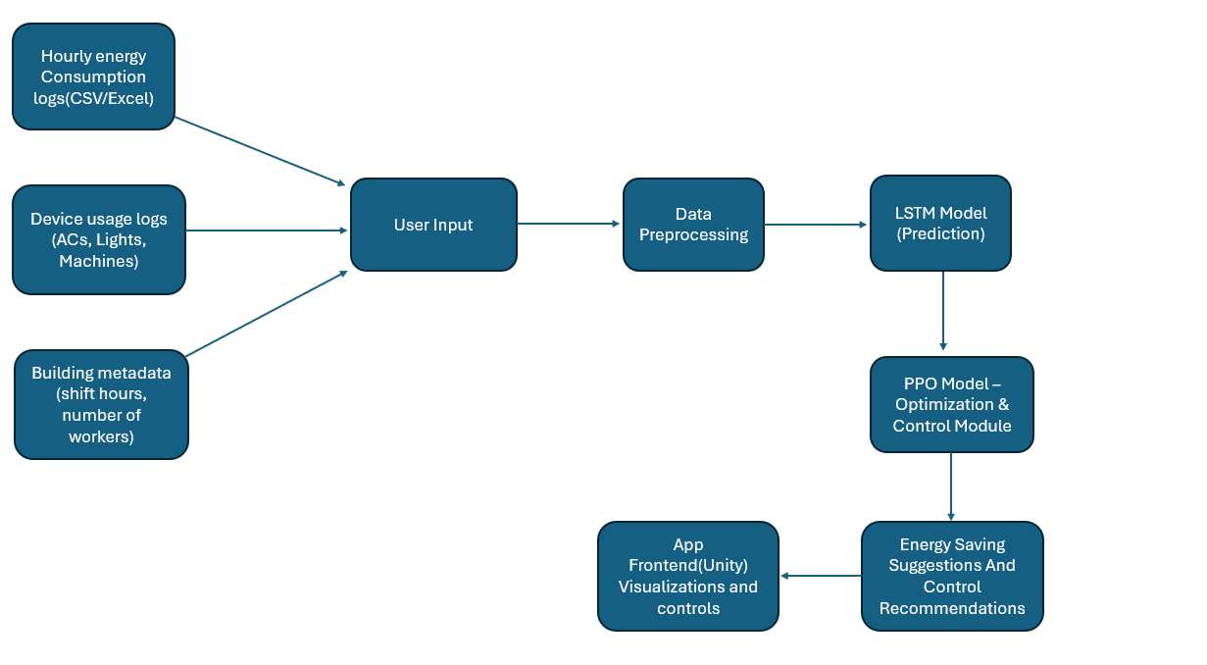
Project Flow Diagram

Slide 11
Results and Discussion
Note – Below mentioned results are based on small scale equipment.
Trained on ~8,000+ records with 5-minute intervals (Sept–Dec 2025 data)
Model learned the relationship between:
Indoor conditions (temperature, humidity, occupancy)
Outdoor conditions (temperature, humidity, wind)
Fan usage patterns
Achieved good accuracy (model correctly predicts ON/OFF in most cases)
Can forecast fan state ahead of time, helping in:
Energy saving
Better comfort control

Slide 12
Conclusion
This project demonstrates how AI-based forecasting combined with reinforcement learning can optimize energy consumption in industrial and commercial buildings. By analyzing historical data and predicting future demand, the system provides intelligent control strategies that improve efficiency while maintaining occupant comfort. The results highlight potential cost savings, reduced energy waste, and support for sustainability goals, making it a practical solution for industries aiming to move towards smarter and greener energy management.

Slide 13
References
[1] R. Teichner, R. Meir, and M. Margaliot, “Analysis of the Identifying Regulation with Adversarial Surrogates Algorithm,” IEEE Control Systems Letters, vol. 8, pp. 1623–1628, 2024, doi: 10.1109/LCSYS.2024.3392559.
[2]A. Manjavacas, A. Campoy‑Nieves, J. Jiménez‑Raboso, M. Molina‑Solana, and J. Gómez‑Romero, “An experimental evaluation of deep reinforcement learning algorithms for HVAC control,” Artificial Intelligence Review, vol. 57, no. 7, art. 173, Jun. 2024, doi:10.1007/s10462-024-10819‑x
[3] H. Wang, X. Chen, N. Vital, E. Duffy, and A. Razi, “Energy optimization for HVAC systems in multi‑VAV open offices: A deep reinforcement learning approach,” Applied Energy, vol. 356, article 122354, Feb. 2024, doi: 10.1016/j.apenergy.2023.122354.
[4] X. Ding, A. Cerpa, and W. Du, “Exploring Deep Reinforcement Learning for Holistic Smart Building Control,” arXiv preprint arXiv:2301.11510, Jan. 2023. doi:10.1145/3656043.
[5] X. Qu and B. Zhu, “Digital Finance and Corporate Cash‑Holding Strategy: Organizational Heterogeneity and Strategic Transmission Channels,” Sustainability, vol. 15, no. 3, art. 2361, 2023, doi: 10.3390/su15032361.
[6] Z. Chen, F. Xiao, et al., “Interpretable machine learning for building energy management: A state‑of‑the‑art review,” Advances in Applied Energy, vol. 9, Feb. 2023, Art. 100123, doi: 10.1016/j.adapen.2023.100123.
[7] U. N. Upadhye and V. Patil, “Efficacy of Agnikarma in the management of Gridhrasi (sciatica)—A Scoping review,” Journal of Ayurveda and Holistic Medicine, vol. 12, no. 10, 2024, doi: 10.70066/jahm.v12i10.1508.
[8] M. Kummer and K. Shaw, “The Separating Semigroup of a Real Curve,” Annales de la Faculté des Sciences de Toulouse. Mathématiques, vol. 29, no. 1, pp. 79–96, 2020.
[9] M. A. Shakir, A. R. Appana, W. Khalid, S. R. P. J. K., and M. I. Ahmad, “Advancing insights into building electrical energy consumption: a comprehensive review of conventional and artificial intelligence methods,” Advances in Building Energy Research, pp. 1–44, Jun. 2025, doi: 10.1080/17512549.2025.2513282
[10] C. Ding, J. Ke, M. Levine, and N. Zhou, “Potential of artificial intelligence in reducing energy and carbon emissions of commercial buildings at scale,” Nature Communications, vol. 15, p. 5916, Jul. 2024, doi:10.1038/s41467-024-50088-4.

Slide 14
Thank You!!

